Slide 1
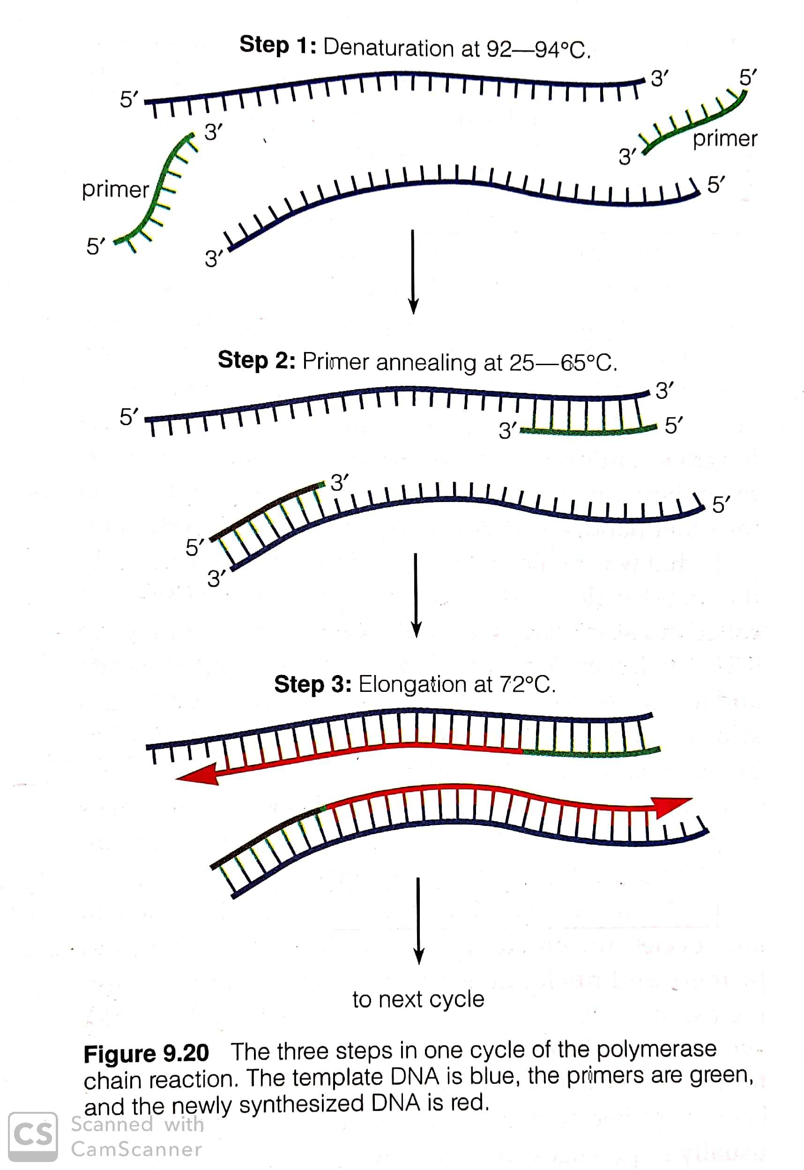
Polymerase Chain Reaction (PCR)
DNA Amplification

Slide 2
Overview
PCR is a molecular Xerox machine for DNA.
PCR is a laboratory (in vitro) technique for generating large quantities of a specified DNA.
PCR amplified DNA to create a two DNA molecules after each cycle.
PCR produces multiple identical copies (billions) of target DNA and it would be 2^{n} after n cycle. In practice 20-40 cycles are used.
PCR procedure involves three steps (denaturation, primer annealing and chain extension) and each repeated many times.
The PCR procedure for amplifying DNA sequences was developed by Kary Mullis in 1984, who received the 1993 Nobel Prize in Chemistry for this work.

Slide 3
What is PCR?
The technique involving multiple cycles of denaturation, primer annealing and polynucleotide synthesis (chain extension) that amplifies a particular DNA sequence to multiple copies of target DNA sequence is called PCR.

Slide 4
Principle of PCR
The dsDNA of interest is denatured to separate into two individual strands.
Each strand is then allowed to hybridize with a primer (renaturation).
The primer-template duplex is used for DNA synthesis (the heat-stable DNA polymerase enzyme).
These three steps- denaturation, renaturatuin (primer annealing) and synthesis (chain extension) are repeated again and again to generate multiple forms of target DNA.

Slide 5
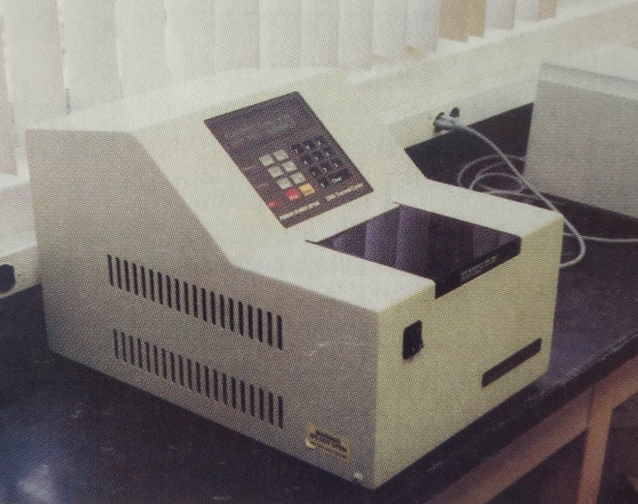
What are the requirements for PCR?
Template DNA: .original starting DNA represents very long molecules with neither end well defined.
Primer: Two synthetic oligonucleotide DNA primers of a sequence of 15-30 nucleotide long that are complementary to the ends of the region being amplified.
Enzymes : required special heat stable DNA polymerase such as –
i. Taq polymerase (isolated from bacteria, Thermas aquaticus) without proof reading capacity,
ii. Pfu polymerase (isolated from bacteria Pyrococcus furiosus) having 3’-5’proof reading capacity,
iii. Tli polymerase( isolated from Thermococcus litoralis) having 3’-5’proof reading capacity,
iv. Tfl polymerase (isolated from Thermus flavus) amplify long DNA fragments up to about 35 kb in length.
4. dNTPS (dATP, dCTP, dTTP, dGTP) & Mg⁺⁺
5. Buffer solutions
6. A thermal cycler : It automatically initiates the cyclic temperature changes.

Slide 6
Advantages and disadvantages of Taq polymerase
Advantages:
It is heat resistant DNA polymerase that acts best at 72ºC and the denaturation temperature of 90ºC does not destroy its enzymatic activity.
It allows the automation of the entire process of PCR.
Disadvantages:
It lacks of 3’-5’ proofreading exonuclease activity and thus if errors are introduced, these are not checked.
It produces a higher than normal frequency of replication errors.
It can not efficiently amplify long DNA with a few thousand nucleotide pairs.

Slide 7
Procedure of PCR
Step 1: Denaturation | Separation of two DNA strands into ss DNA by heating at 92-95ºC for 30 seconds.
Step 2: Primer annealing | The denatured strand is annealed to an excess of the synthetic oligonucleotide primers by incubating them together at 50-60ºC for 30 seconds. The ideal annealing temperature depends on the base composition of the primer.
Step 3- Chain extension | Heat stable DNA polymerase added nucleotide to the 3’-OH group of primer and then extended the polymerization by adding complementary dNTPs at 70-72ºC for 1.5 minutes.
A single cycle of PCR doubles the numbers of copies of a target sequence and can be
performed in 3-5 minutes. This three procedure is repeated many times until the desired
level of amplification is achieved. So the number of copies of target sequence will be 2n
(where n= number of cycle). Generally 25-35 cycles produces enough DNA to be visible
On an electrophoresis gel.

Slide 9
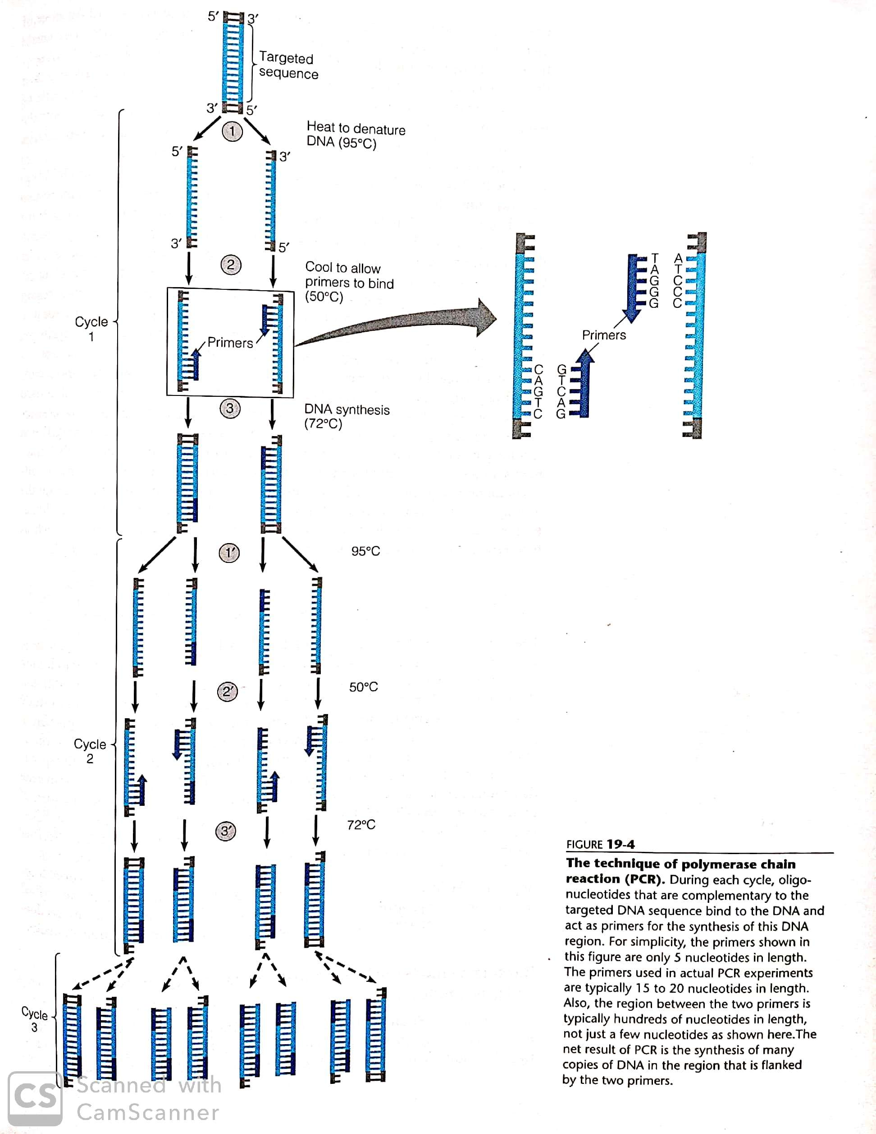

Slide 10
Key factors for optimal PCR
Primers design : The primers (17-30 nucleotides) without secondary structure and without complementary among them selves are ideal for PCR.
DNA polymerase: The polymerase should be heat stable.
Target DNA: in general, the shorter the sequence of target DNA, the better is the efficiency of PCR. The GC rich sequence in target DNA strand hinder PCR.
Annealing temperature.
Mg ⁺⁺ ion concentration.

Slide 11
Advantages & Disadvantages of PCR
Advantages:
It is rapid, greater sensitive than any other method available for analyzing nucleic acid.
It is useful in generating large quantities of specific DNA sequences without need for cloning.
It can work even to operate with partly degraded DNA or extremely minute amounts of starting materials.
Disadvantages:
Only short region (up to 2kbp)can be amplified.
Limited amount of products are made.
Limitation in designing primer of defined sequence
Exact Mg⁺⁺ concentration.
Limitation in setting exact annealing temperature.
Chain extension timing.

Slide 12
Application of PCR
Gene mapping
Generation of genetic marker.
Diagnosis of inherited genetic defects in humans
Diagnosis of retroviral infection, bacterial infection.
DNA sequencing
Gene cloning.
DNA fingerprinting.
Forensic sciences
Cytotaxonomy study of genome.
Evolutionary biology study.

Slide 13
Types of PCR
Types | Description
RT-PCR | It uses reverse transcriptase (RT) to convert mRNA into DNA, which is then amplified with PCR.
Anchor-primed PCR | It uses one sequence-specific primer and a set of random primers for the other end.
Allele-specific PCR | It is used for base change mutations (single nucleotide polymorphism)
Nested PCR | Here in the second round of PCR, a new set of primers are used that anneal with the fragment amplified by the first primer.
Multiplex PCR | If multiple primers are used for amplification of more than one DNA in the same DNA.
Inverse PCR | The genomic DNA is first digested with RE followed by ligation then amplification.
Quantitative PCR | By this PCR, the amount of DNA can be determined.
Asymmetric PCR | Here only one strand is amplified (in a linear fashion).
Real time PCR | The thermal cycler can determine the amount of product.

