Slide 1
Classification of Phylum Annelid

Slide 2
Introduction
Phylum Annelida is a very broad phylum belonging to the kingdom Animalia.
The term ‘annelida’ is derived from Latin word ‘annulus’ meaning small ring.
Lamarck first coined the term ‘Annelida’ in 1802
These are bilaterally symmetrical invertebrate organisms whose body is composed of rings arranged linearly in an antero-posterior axis.
They are metamerically segmented animal with a thin flexible cuticle around the body.
They are the first coelomate animals.
The Annelids are found in aquatic as well as terrestrial environments.

Slide 3
Definition of Phylum Annelida:
Annelids are bilaterally symmetrical, elongated, metamerically segmented eucoelomate worms with a thin flexible cuticle around the body and containing segmental chitinous setae.

Slide 4
General characters
The Annelids are coelomate and triploblastic.
Their body is metamerically segmented.
They respire through their body surface.
Nephridia are the excretory organs.
Body covered by thin flexible cuticle.
Body cavity often subdivided by transverse septa.
They have a well-developed circulatory and digestive system.
Their body contains haemoglobin, which gives them a red colour.
Regeneration is a very common characteristic of the Annelids.
Presence of setae help them in locomotion
Most of the Annelids are hermaphrodite

Slide 5
Scheme of classification ( Ruppert and Barnes, 1994)

Slide 6
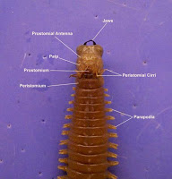
Polychaeta
They are found in the marine environment.
Head consists of prostomium ( anterior most part) and peristomium and bears 1 pair of eyes, 1 pair of tentacles, cirri and palps
Presence of numerous chaetae or bristles, inserted in two groups in the biramous segmental parapodia (fin-like appendages)
The organisms belonging to this group lack clitellum and are dioecious. Eg., Nereis, Syllis

Slide 7
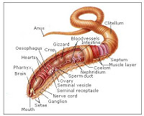
Oligochaeta
They are mostly freshwater and terrestrial organisms.
The body is segmented metamerically.
Head indistinct, prostomium is either small, rounded lobe or a small cone without appendages, eyes and tentacles are not distinct.
Setae are segmented.
Body segment lack parapodia but have setal sacs from which setae as group of bundle.
Clitellum is present.
They are monoecious. They are hermaphrodites, but cross-fertilization takes place.
They exhibit no free larval stage and the development takes place inside the cocoons.
Eg., Pheretima, Tubifex

Slide 8
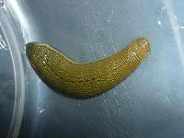
Hirudinea
Most commonly found in freshwater. Some are marine, terrestrial, and parasitic.
The tentacles, parapodia, and setae are not present.
The animals are monoecious.
Dorsoventrally flattened, pigmented body made of 33 segments, marked externally by secondary rings or annuli.
They have an anterior and posterior sucker on the ventral side.
The mouth is located ventrally in the anterior sucker, while the anus is present dorsally in the posterior sucker.
Fertilization is internal.
They are hermaphrodites.
Eg., Hirudinaria, Hirudo

